Slide 1
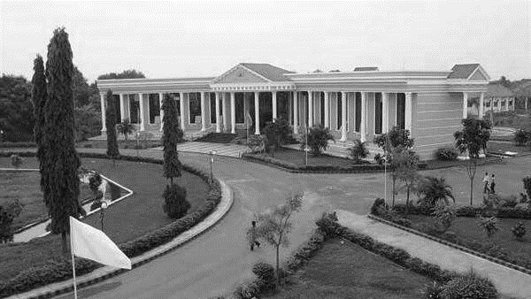



BLOOD BANK MANAGEMENT SYSTEM
Presented By:
LOHESHWARI AG
510419104042
DEPARTMENT OF CSE
ARUNAI ENGINERING COLLEGE
THIRUVANAMALAI
DEPARTMENT OF
CSE

Slide 2

ABSTRACT
This project is aimed to developing an online Blood Donation Information.
The entire project has been developed keeping in view of the distributed client server computing technology, in mind.
The Blood Donation Agent is to create an e-Information about the donor and organization that are related to donating the blood
Through this application any person who is interested in donating the blood can register himself in the same way if any organization wants to register itself with this site
Moreover if any general consumer wants to make request blood online
he can also take the help of this site.
Admin is the main authority who can do addition, deletion, and
modification if required.

Slide 3

DOMAIN
In our project we were using WEB Development

Slide 4
PROBLEM STATEMENT
Problem
The major problem in old Blood banking systems was that, they don’t follow the
actual needs of users.
Traditional blood banking systems were developed by 1 or 2 perspective.
Tracking the database was complicated when the details are maintained manually.
There was shortage and sometimes unavailability of rare blood groups due to less modules i.e. patient and donors.
The BBMS interface will be constructed to cater for the blood house staff to post about the blood donation events.
These details can be viewed by the public so that they know and they can allocate some time to go and donate their blood.

Slide 5

PROBLEM STATEMENT
Solution
A better idea is to use the application which Mobile device is very popular with people too.
This application is providing each entity the facility to approach nearby blood donors so that it will become much easier to search rare blood groups in the hour of need.

Slide 6
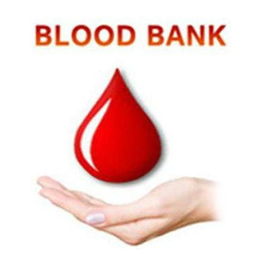
OUR IDEA
Web-based Blood Donation Management System is a management system website that enables individuals who want to donate blood to help the needy.
It also enables hospitals to record and store the data for people who want to communicate with them, and it also provides a centralized blood bank database.
The system is developed by using HTML, PHP and MySQL as a database system to manage and store the data.
The Waterfall Methodology, which is the traditional version and
The classic approach of a system development life cycle, is used to
develop and build the web-based blood bank

Slide 7

OUR IDEA
The system targets three types of user: the public who wants to donate blood, the recipients who need the donated blood, and the hospitals who that work as an intermediary to manage the communication between the donors and recipients.
The main objectives for developing the website is to educate the community on the benefits of blood donation
develop a Web-Based Blood Bank System to manage the records of donors and recipients
encourage voluntary blood donation
easily accessing any information about blood type

Slide 8

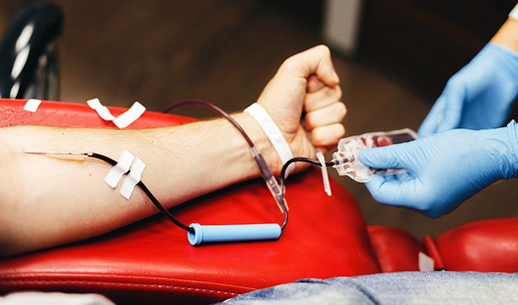
REQUIREMENTS
Software Requirements:
Windows 10 or higher.
PHP
XAAMP Server.
MySQL database.
Hardware Components:
Processor –Corei3
Hard Disk – 160 GB
Memory – 1GBRAM

Slide 9
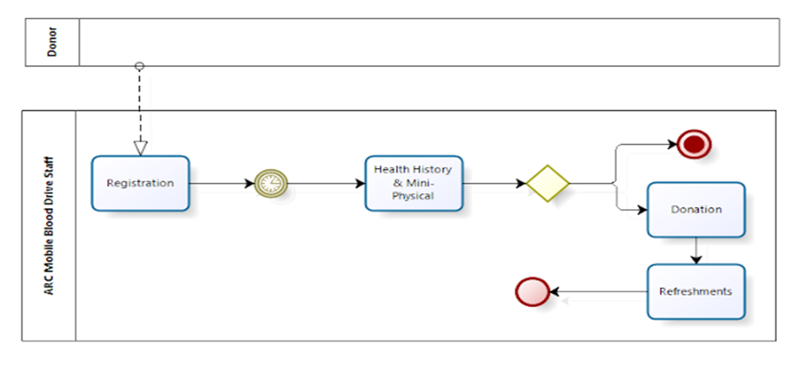
FLOW CHART

Slide 10

ADVANTAGE
This project has a login page which allows only the registered user to login and thereby preventing unauthorized access.
This system can be used to view all the donor details and accordingly select the right donor.
The android mobile user will be able make quick decision in selecting a donor.
Usage of this application will greatly reduce timein selecting the right donor.

Slide 11
CONCLUSION
This proposed Blood Bank Management System gives a reliable platform for both donors and acceptors.
The BMMS is a web-based application that helps to minimize human errors and problems pertaining to data redundancy.
It is a fast-paced and efficient way to communicate without any security threats as the data entered will be verified and frequently updated thereby increasing the probability of saving one's life.
Moreover, the availability of a location-based system where the nearest blood bank can be located through Google maps

Slide 12

FUTURE ENHANCEMENT
FUTURE ENHANCEMENT
User login: This allows only the registered users to login in order to use this location tracking application.
Donor details: This module helps the donor to insert all the necessary details that is personal information and medical information plus the blood group which together helps to select a donor.
Procurer details: The android mobile user can view all the donor details and select the required donor on the basis of the donor’s information

Slide 13
THANK YOU
DEPARTMENT OF
CSE

